Slide 1
Supervisors Training Package
Dr David Yorston, Curriculum 2024 TTT Lead
Mr Vikas Chadha, Curriculum Sub-Committee Chair
August 2024

Slide 2
Objectives
After completing this package, participants will:
Have a better understanding of the changes in the new curriculum
Know what trainees need to accomplish at each level
Be able to complete EPA, MAR & GSAT forms

Slide 3
Curriculum 2024- why?
Ophthalmology training in the UK
7 years + post training fellowships for almost all
Ophthalmology training in the rest of the world
3-4 years + post training fellowships for some
GMC
Doctors should be able to complete their training in 7 years or less
Are Fellowships really needed?
RCOphth
“Hold my beer!”

Slide 4
Current Curriculum
Numbers based
350 ops defines a “competent cataract surgeon”
- Some trainees are competent after 200
- Others still need supervision after 500
Struggle to get 20 strabismus operations
? Tick-box exercise
Doesn’t fit with current working practices
Trabeculectomy now only done by glaucoma specialists
Some consultants do not perform cataract surgery after 7 years of training in it
Repetitive
Trainees do the same sub-specialty more than once – how much more do they learn?

Slide 5
Curriculum 2024
Based on competence, NOT numbers or time
Fewer WpBAs, less box ticking
All trainees to reach level of general ophthalmology consultant in all special interest areas (Level 3); maximum 5.5 years
-Eg manage acute glaucoma over a bank holiday weekend
Generic skills are mandatory - SIX domains
Incorporates Special Interest Area (sub-specialty) training - Level 4
All trainees to reach level of sub-specialist in two special interest areas

Slide 6
Levels of training

Slide 7
Domains
Patient Management
Health Promotion
Leadership & Team Working
Patient Safety & Quality Improvement
Safeguarding & Holistic Patient Care
Education & Training
Research & Scholarship
TWELVE Special Interest Areas (SIAs)
Oculoplastics and Orbit
Cornea and Ocular Surface Disease
Cataract Surgery
Glaucoma
Uveitis
Medical Retina
Vitreoretinal Surgery
Ocular Motility
Neuro-ophthalmology
Paediatric Ophthalmology
Urgent Eye Care
Community Ophthalmology

Slide 8
Levels
Level 1
Able to examine patient and manage uncomplicated conditions
Part 1 FRCOphth
Latest waypoint for completion - end of ST2
Level 2
As for Level 1 but at an acceptable rate
Refraction certificate
Latest waypoint for completion - end of ST3
Level 3
Practice at the level of a consultant, not a sub-specialist, in all 12 SIAs
Part 2 FRCOphth, written & clinical
Latest waypoint for completion - middle of ST6 (5.5 years)
Level 4
Practice at the level of a sub-specialist in two SIAs
Latest waypoint for completion – end of ST7
Likely timelines for most trainees
ST 1-2: 2 years
ST 3-6.5: 3 yrs 6 mo
ST 6.5-7: 1 yr 6 mo

Slide 9
How will Level 3 be possible?
Cataract Surgery, Community Ophthalmology & Urgent Eye Care competences learned in all placements
Level 3 Competencies are those of a general ophthalmologist (e.g. does not need to do trabeculectomy, does not need to assist vitrectomies etc)
Some placements incorporate two SIAs (e.g. Medical Retina & Uveitis, Paediatric Ophthalmology & Strabismus, Neuro-ophthalmology & Ocular Motility
Trainees can choose to stop Cataract Surgery at Level 3 if they do not wish to perform Cataract Surgery as a Consultant

Slide 10
Level 4 Training
Minimum of TWO Level 4 SIAs need to be completed for CCT
Latest time for entry into Level 4 is after 5.5 years of training
Level 4 entry criteria
- FRCOphth Part 2
- Level 3 in all SIA and all Generic Skills
Level 4 entry criteria for Cornea & Ocular Surface, Glaucoma and Vitreoretinal Surgery
- As above
- PLUS Competencies of Level 4 Cataract Surgery

Slide 11
Level 4 in VR, Cornea, Glaucoma
Need Level 4 Cataract Surgery signed off before entry to Level 4 in these three SIAs
If NOT signed off and the panel (Clinical Supervisors and TPD) feel that the trainee will be able to get it signed off within the first 6 months of the Level 4
- review the application and the ePortfolio
- make a decision to request exemption
- write to Chair of Training and Curriculum Sub-committee Chair with details

Slide 12
Level 4 training
Outcomes specified in Curriculum 2024
Will be deliverable in trainee’s own deanery in almost all cases
Currently deaneries estimate over 400 potential Level 4 training places in all SIAs across the country!
Where more than one trainee applies for same Level 4 post:
Selection based on review of ePortfolio
Selected by clinical supervisors in the SIA, with TPD oversight
No exam/interview permitted by GMC regulations
Application form (regional)

Slide 13
Level 4 duration
Up to 18 months
Cornea, Glaucoma, Ocular Motility, Oculoplastics & Orbit, Paediatric Ophthalmology, Vitreoretinal Surgery
12-18 months
Medical Retina, Neuro-ophthalmology, Uveitis
6-12 months
Community Ophthalmology, Urgent Eye Care
PURELY INDICATIVE DURATIONS: Curriculum 2024 is
COMPETENCY-BASED, not number or time-based

Slide 14
Post-CCT Fellowships
Funded by Trust/Health Board
- Not overseen by RCOphth, unaffected by Curriculum 2024
- No study leave funding
- No defined learning outcomes (no standardisation)
Most UK trainees will do Level 4 rather than post-CCT or AMT Fellowships
Still have a role for
Further experience in niche special interest eg Oncology, Paediatric Glaucoma, Orbit
3rd SIA – e.g. paeds, ocular motility
Further experience in SIA (e.g. VR as a second Fellowship)
If limited learning opportunities, priority is Level 4 training

Slide 15
Advancement between Levels
Will be possible in August and February
ARCPs will stay an annual event with Winter ARCPs only required in specific circumstances
Completion of a Level will be predicted at the ARCP based on the ES report and documented in the ARCP following the completion
Advancement between Levels does not need an ARCP to take place - it can be done based on the evidence review by the ES
This evidence will include the EPA and GSAT

Slide 16
Advancement
EXAMPLE 1
ST1-2 completes 50 phacos, but does not enjoy it
Fascinated by diagnostic dilemmas
Achieves Level 2 at year 2.5 (reminder, max is 3; does not need ARCP)
Achieves Level 3 cataract surgery at end of ST3 - drops Cataract Surgery sessions
ST4-5 Completes Level 3 in all other SIA and Part 2 FRCOphth by end of ST5
ST6-7 Level 4 training in Medical Retina and Uveitis
CCT, and Consultant in Medical Retina and Uveitis

Slide 17
Advancement
EXAMPLE 2
ST1-2 completes 75 phacos, and enjoys challenge of intraocular surgery
Completes Level 2 at end of ST2
At ST3 ARCP, indicates she wants to do Vitreoretinal Surgery
ST4-5 Completes Level 4 in Cataract Surgery and Level 3 in all other SIA and Part 2 FRCOphth
ST6-7 Level 4 training in Vitreoretinal Surgery
CCT, and either Consultant Vitreoretinal surgeon, or may go on to post-CCT fellowship

Slide 18
Generic skills
Health Promotion
Leadership & Team Working
Patient Safety & Quality Improvement
Safeguarding & Holistic Patient Care
Education & Training
Research & Scholarship
NO advancement to next Level unless all competencies of generic domains achieved for the previous level
Level 4 competencies in all Generic domains before CCT
RSTAC- Research, Study, Teaching, Audit, Curriculum competencies
Increased importance of appropriate utilisation of RSTAC sessions

Slide 19
What do trainees need to learn?
Learning outcomes - All Levels - All Domains:
https://curriculum2024.rcophth.ac.uk/

Slide 20
New Assessments
1. Entrustable Professional Activity (EPA)
- replaces the current clinical supervisor report (CSR)
2. Multi-Assessor Reports (MAR)
- clinical assessments from other clinicians and professionals
3. Generic Skills Assessment Tool (GSAT)
- key method to assess all generic domains; Trainee driven

Slide 21
EPA
The most important assessment tool in C2024
Global assessment of trainee’s competence rather than tick box
Starts with trainee’s own self-assessment
Review of evidence to demonstrate competence
Named Clinical Supervisors will be allocated for each trainee every six months for Level 1, Level 2 and each SIA in Levels 3 and 4

Slide 22
EPA
At least ONE every SIX months
Levels 1 and 2 will have ONE every six months
Levels 3 and 4 may have more than one every six months as there is a separate EPA for every SIA in these levels
EPA is completed by trainee and the NAMED CLINICAL SUPERVISOR
Only ONE named clinical supervisor responsible for each EPA
Replaces CURRENT Clinical Supervisor Report

Slide 23
EPA - Evidence
In current curriculum, evidence is WpBA – little place for global judgement of trainer
In Curriculum 2024, evidence may be:
WpBA – e.g. CRS, CBD, OSATS, MSF; only SOME REMAIN MANDATORY, rest are optional; NO TRAFFIC LIGHT SYSTEM
Observation – NCS has seen the trainee do it and is satisfied with performance. No paperwork required
MAR – Observation by another Consultant or health professional e.g. orthoptist observing motility assessment; consultant in another SIA observing relevant competencies (at least one)

Slide 24
MAR
MULTI-ASSESSOR REPORTS
One universal form, not specific to any Level
Clinical assessments from experienced professionals that contribute to EPA
Who are these Assessors?
- All other Consultants trainee is working with in the week
- Senior trainees or Consultants with whom trainee was on-call or did an casualty/
acute referral clinic
- Any other appropriate clinicians/ orthoptists/ optometrists
- Determined by Named Clinical Supervisor and Trainee

Slide 25
GSAT
GENERIC SKILLS ASSESSMENT TOOL
ONE assessment form covers all SIX generic domains for ONE Level
Trainee-driven:- Trainee fills in the entire form and adds on the evidence for each domain
Responsibility of Educational Supervisor to sign off
ONE every SIX months

Slide 26
Who’s who for the trainee?
Head of School
Training Programme Director
College Tutor
Educational Supervisor - ONE per six months
Named Clinical Supervisor
- One per SIX months for Levels 1 and 2
- One per SIX months per SIA for Levels 3 and 4
Assessors
Current ‘CLINICAL SUPERVISOR’ role will not exist -
converted to either Named Clinical Supervisor or Assessor or Both

Slide 27
Curriculum 2024 Supervisors
EDUCATIONAL SUPERVISOR
Educational progress towards ARCP: Similar to current role
Responsible for
- GSAT (Generic skills Assessment Tool)
- ESR (Educational Supervisor Report)
GSAT- primarily trainee-driven
ESR- simpler and more intuitive: Role essentially unchanged

Slide 28
Curriculum 2024 Supervisors
NAMED CLINICAL SUPERVISOR
A Consultant working with trainee in the rotation
ONE named clinical supervisor for every six months in Level 1 and Level 2
ONE named clinical supervisor for every SIA every six months for Levels 3 and 4
Responsible for EPA (Entrustable Professional Activity)
Should complete the EPA after consultation with other Consultants in the rotation (Assessors)

Slide 29
Summary of new assessments
ASSESSMENT | HOW MANY? | WHO? | TOOLS USED TO COMPLETE ASSESSMENT
EPA holistic assessment of competency of trainee in a patient-mgmt domain | One every six months for Levels 1 and 2 One for every SIA (Special interest area) in Level 3 One every six months per SIA for Level 4 | Named Clinical Supervisor | Longitudinal observation, MAR (s), mandatory WpBAs, optional WpBAs
MAR clinical assessment from others as all competencies may not have been witnessed by NCS | No number specified (will feed into the EPA) | Assessors- Other Consultants or clinicians Other qualified professionals (eg orthoptist, optometrist, nurse practitioner) | Direct observation; Other indirect evidence or feedback
GSAT one form for assessment of competencies for all non-clinical domains | One every six months | Educational Supervisor | Evidence demonstrated by trainee

Slide 30
Framework of assessments
ESR (2/yr)
- educational supervisor
EPA (at least 2/yr)
- named clinical supervisor
MAR(s)
- consultants and other clinicians
Other WpBAs
MSF (1/yr)
GSAT (at least 2/yr)
- clinical or educational supervisor
MAR (s)
- other professionals

Slide 31
The Highlights
Significantly decreased workload of WpBAS
No mandatory number of CbDs
One Named Clinical Supervisor for each trainee - therefore decreased number of CSR equivalents (EPA)
Other Consultants working with trainee are Assessors - fill in a much shorter and simpler form (MAR)
Modified ESR- online, simpler, intuitive, embedded data
Generic Skills Assessments (GSAT) - driven by Trainees; detailed guidance in Curriculum Handbook Handbook

Slide 32
Resources
Regional Curriculum Network- HoS, TPDs, Trainee Champions
Website – new microsite
Curriculum 2024 Handbook- final version published on 1 June
Email Curriculum2024@rcophth.ac.uk

Slide 33
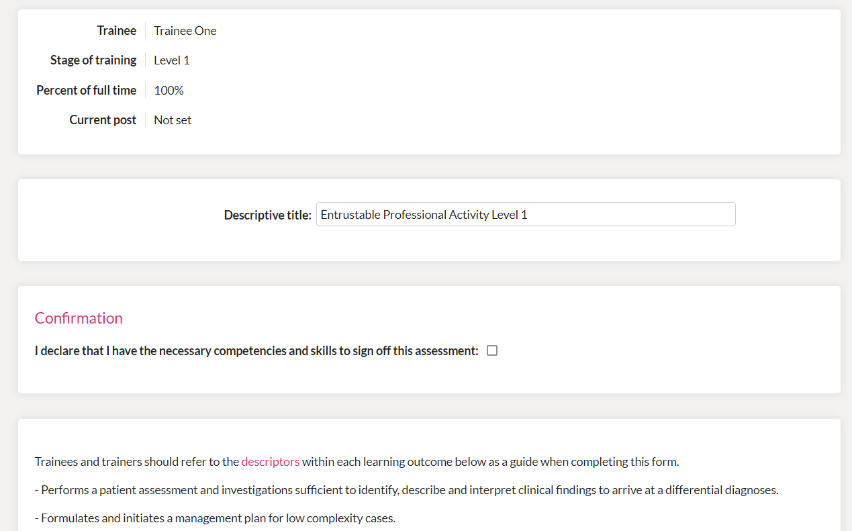
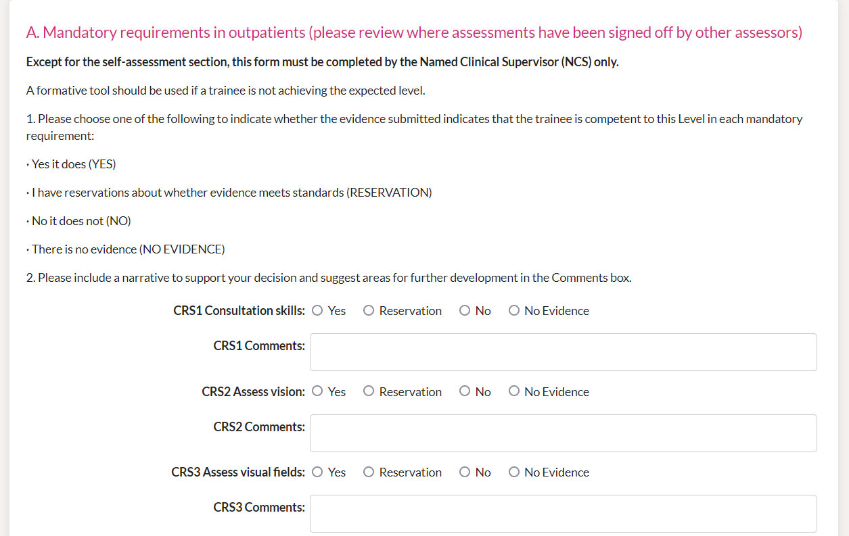
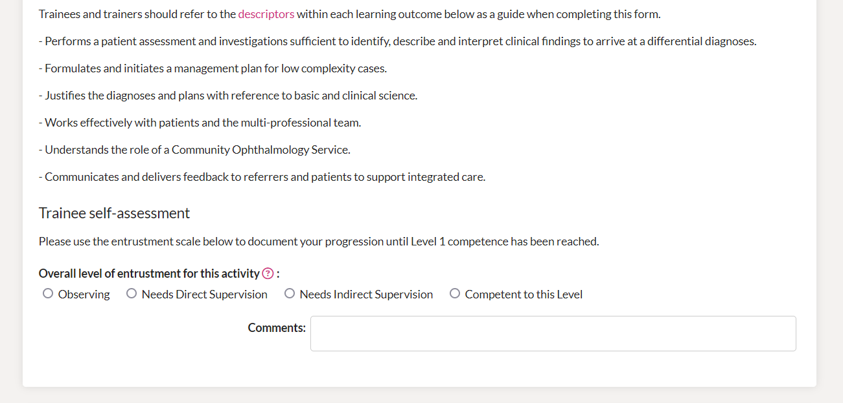
What the new assessments look like: EPA 1

Slide 34
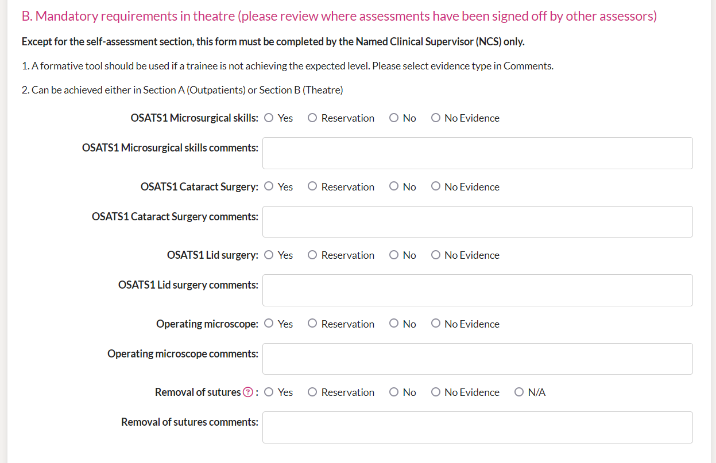
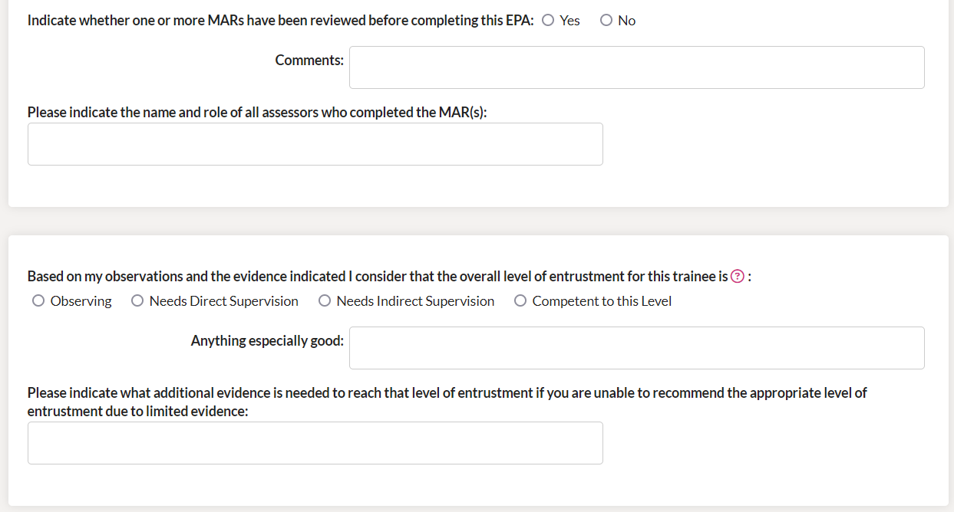
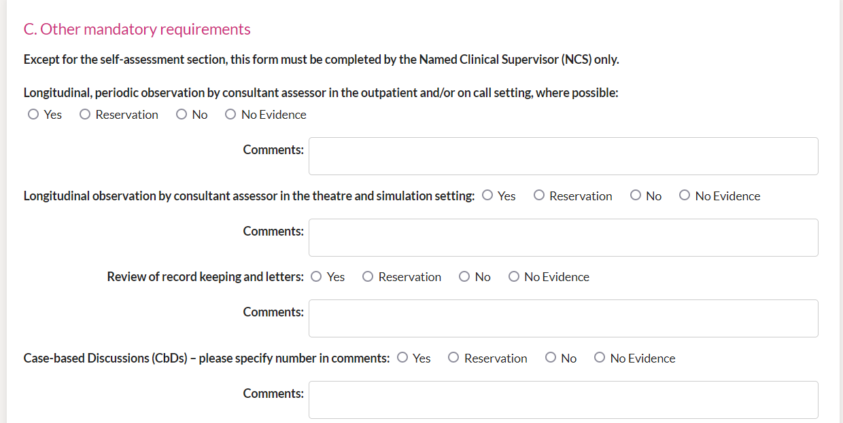
What the new assessments look like: EPA 2

Slide 35
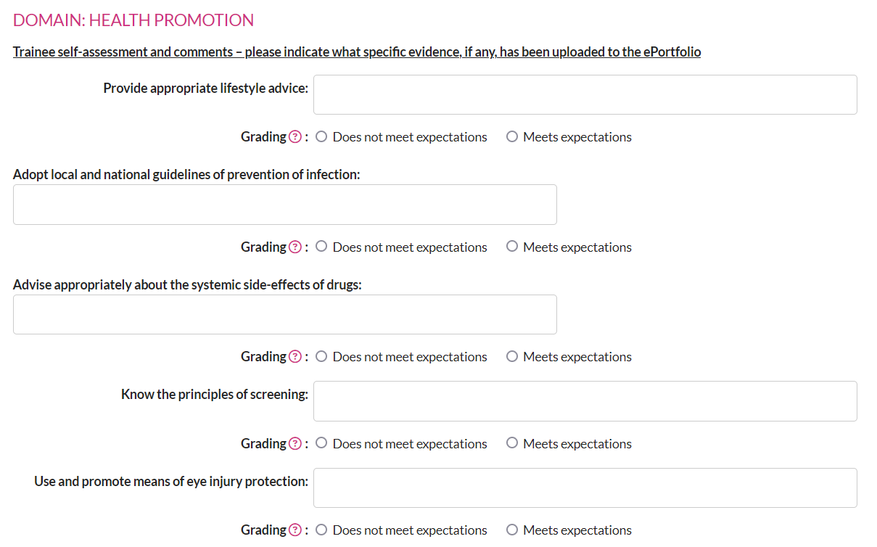
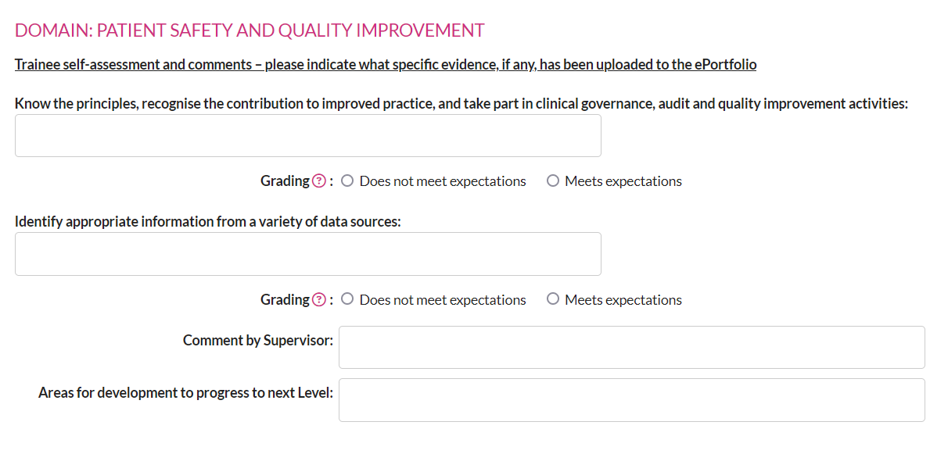
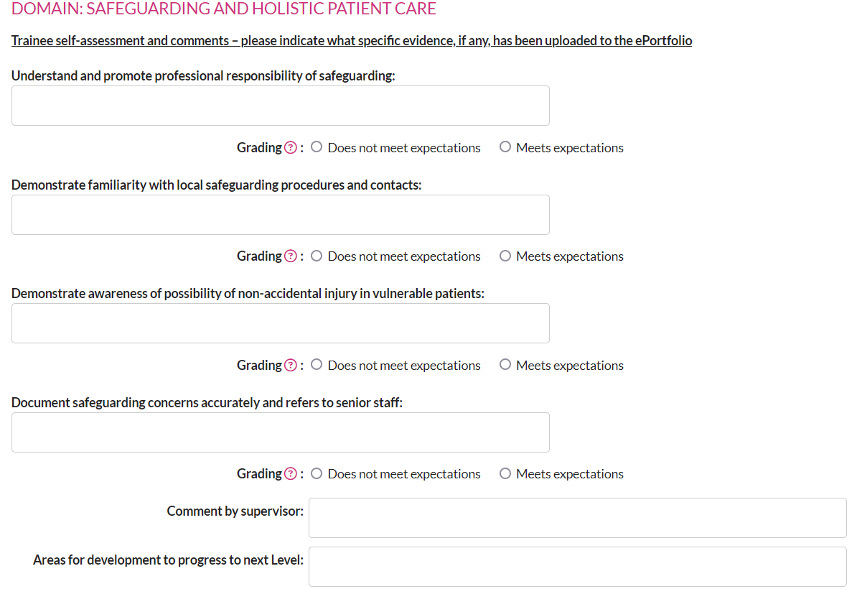
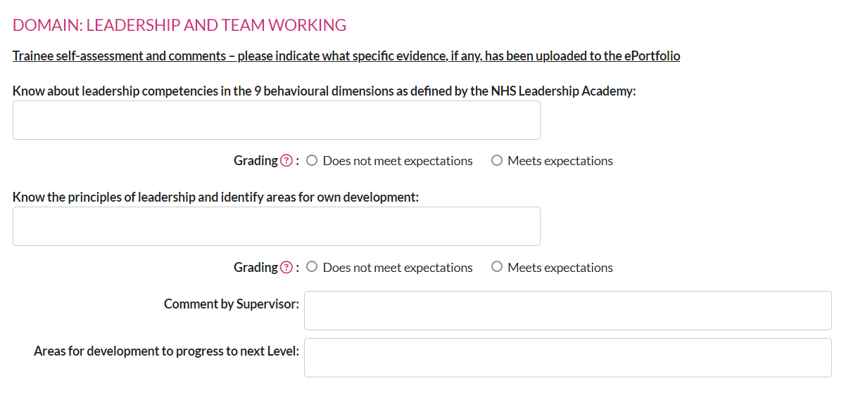
What the new assessments look like: GSAT 1

Slide 36
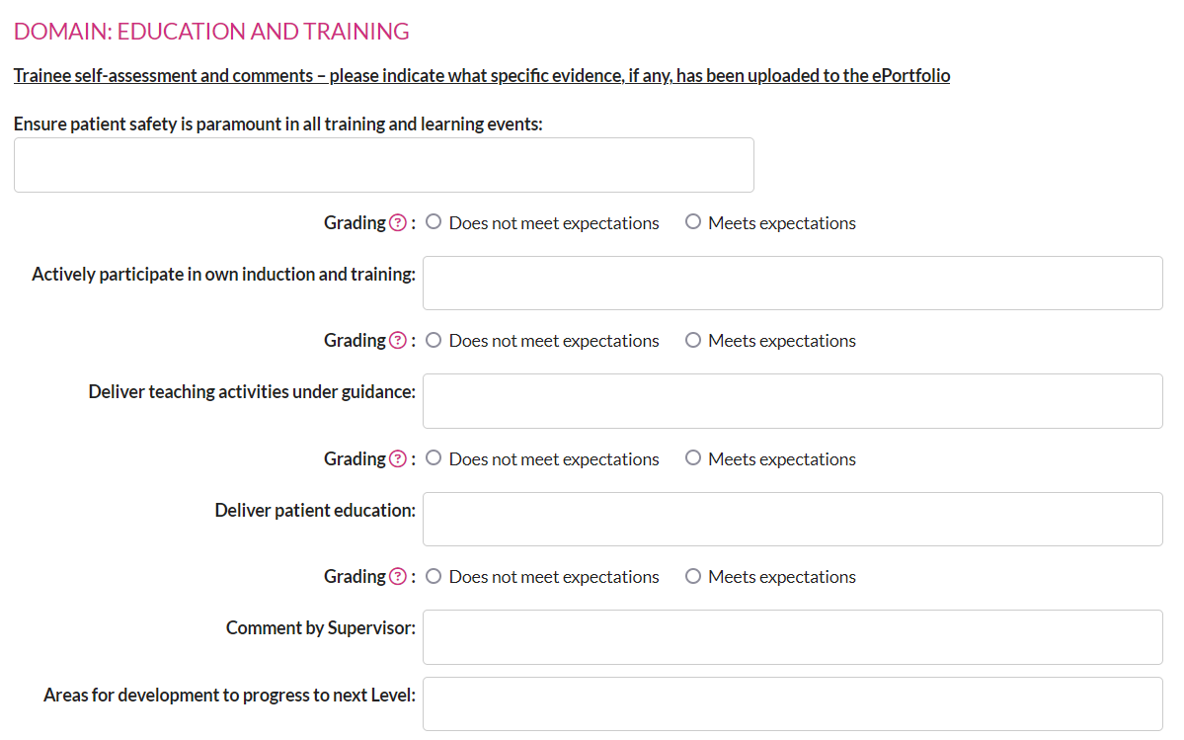
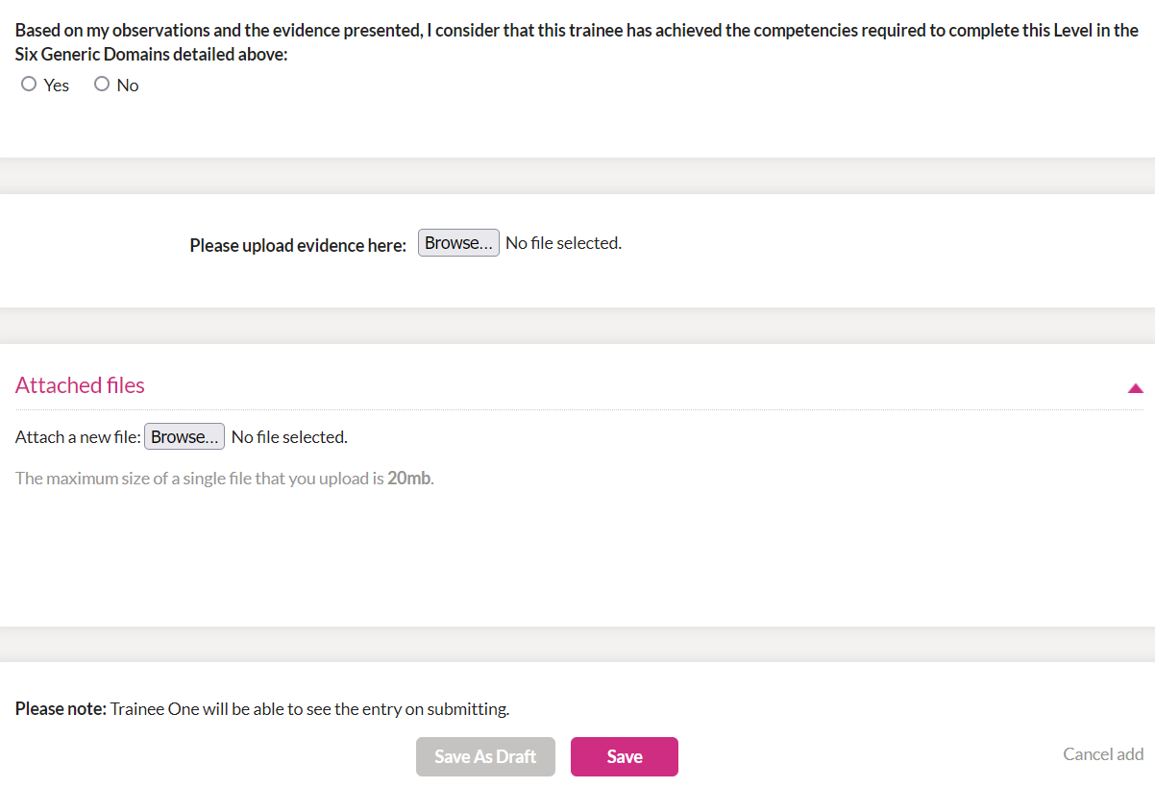
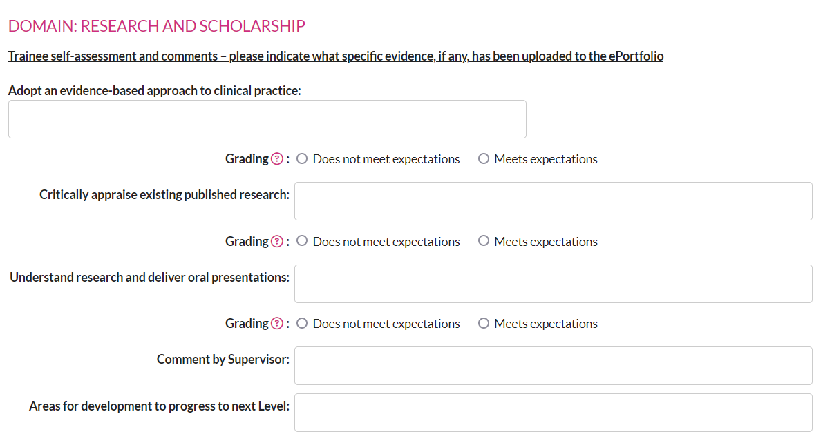
What the new assessments look like: GSAT 2

Slide 37
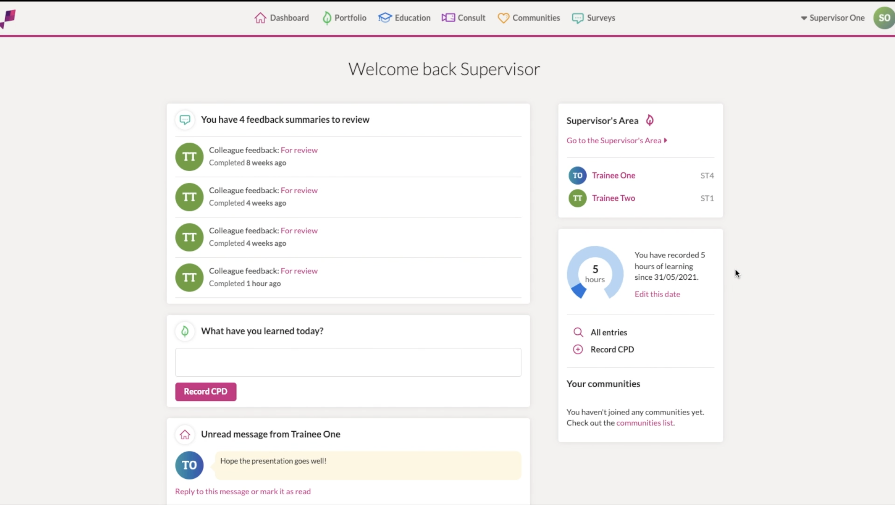
New ePortfolio
Trainees will not be able to use the old ePortfolio from 1 August 2024
All data will be migrated to the new ePortfolio over time
New ePortfolio will cater for current curriculum until August 2026
Functionality for non-trainee ophthalmologists to accumulate evidence for alternative routes to registration (Portfolio Pathway)

Slide 38
How to do an EPA (Exercise 3)
This video demonstrates the Named Clinical Supervisor in Vitreoretinal Surgery going through all the evidence of a Level 3 trainee and completing an EPA at the end of a 6-month VR rotation

Slide 39
Exercises
To understand how Curriculum 2024 works in practice, think about real world examples:
Exercise 1
First meeting with new trainee
Familiarisation with Level 1 outcomes and EPA form
Exercise 2
6 month review meeting with Level 1 trainee
Assessing progress against learning outcomes and setting objective
Exercise 3 DEMONSTRATION EXERCISE - see Video
Exercise 4
6 month review meeting with Level 3 trainee in Oculoplastics & Orbit
Familiarisation with Level 3 EPA and assessments
Exercise 5
Completing GSAT for Level 3 ST4 prior to ARCP
Familiarisation with GSAT form, setting objectives in generic skills

Slide 40
Exercises
In all the exercises, you have been given some resources, however these are not complete.
You should also refer to:
Curriculum 2024 Handbook
Curriculum 2024 syllabus
Think about what evidence may be used to demonstrate competence in any learning outcome
You decide what constitutes satisfactory evidence
Not just a tick box completion of a mandatory WBA
Be creative – particularly for generic skills

